Slide 1

Stats II Replication: Latura & Weeks (2021) - Corporate Board Quotas and Gender Equality Policies in the Workplace
Olivia Daly

Slide 2
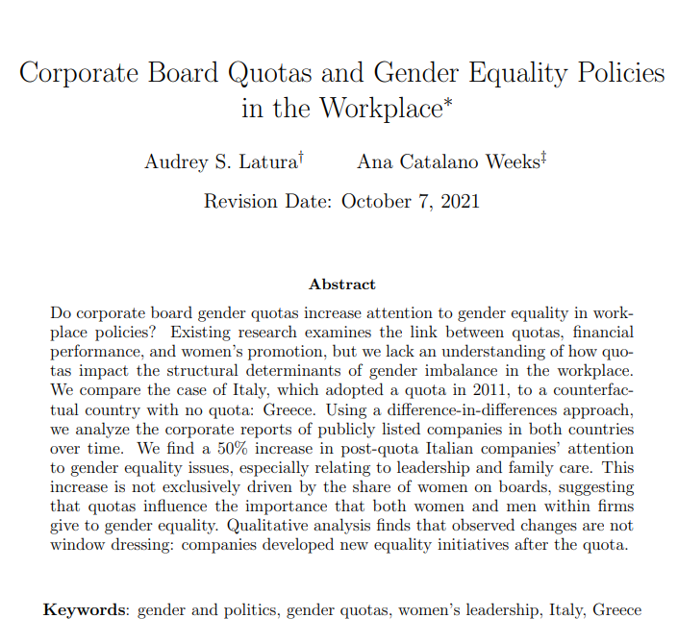
Data:
Company reports from Italy, where gender equality quotas were legally required on corporate boards from 2011, and Greece as a control country, where conditions were similar before 2011 but no quotas were added
Relevant words and phrases in company reports were made into tokens to be quantified and put into different categories for which kinds of policies they related to
Main Independent Variables:
Quota (implemented (Italy) = 1, not (Greece) = 0), sustainability (ie the type of company report that was written bc the sustainability ones (=1, other =0) had more of a focus on progressive policies and employees- so they’re controlling for the type of report and its style here), % revenue change (is revenue perhaps a confounder driving policy change?)
(Quotas is the main one being looked at, the others were potential confounders)

Slide 3
Dependent Variables:
prop attn (Overall = Share of report devoted to gender equality issues) –
-prop_lead (Leadership = Share of report devoted to gender gap in leadership), prop_pay (Pay = Share of report devoted to gender pay gap),
prop_family (Family Care = Share of report devoted to family care (ie., childcare, birth/maternity, family leave, and scheduling flexibility)),
prop_harass (Discrim/Harass = Share of report devoted to sexual discrimination and harassment)
Proportion refers to overall share of report devoted to policies- continuous numerical value

Slide 4
Hypotheses:
H1: Quotas –> ↑ overall attn. to gender equality
H2: After a quota, companies are likely to increase policies and programs to help close the gender gap in leadership and pay, as well as work-family reconciliation, but not sexual harassment and discrimination.
H3: We expect to observe the spillover mechanism if gender quotas for corporate boards increase companies’ overall attention to issues affecting women and gender equality after the law was adopted but before companies were required to comply (distinguishes between passage of a quota law and its implementation – does even the idea of a quota make people pay more attention to the issue, and not just the presence of women on boards themselves?)
***Note- law only got fully enforced in 2014 but started being implemented from 2011 onwards- there was a grace period where companies were gradually adopting it
H4: We expect to observe the identity mechanism if the size of the effect of quota laws on company attention to women and gender equality is greater for companies characterized by greater “shocks” of women joining the board after the quota law (distinguishes based on the degree of implementation of the quota- do more women increase more gender equal policies, or is this not automatically the case, given, for example, that not all women are feminists? Is something else driving policy change after quotas, e.g. spillover effect in H3?).
Original Additive Model Testing H1 and H2:
Yit = β1Quotait + β2Sustainabilityit + β3% Revenue Changeit + αi + ηt + µit
Model Testing H3:
Yit = β1Quotait ∗ Y ear + β2Sustainabilityit + β3% Revenue Changeit + αi + ηt + µit
Model Testing H4:
Yit = β1Quota Shockit + β2Sustainabilityit + β3% Revenue Changeit + αi + ηt + µit

Slide 5
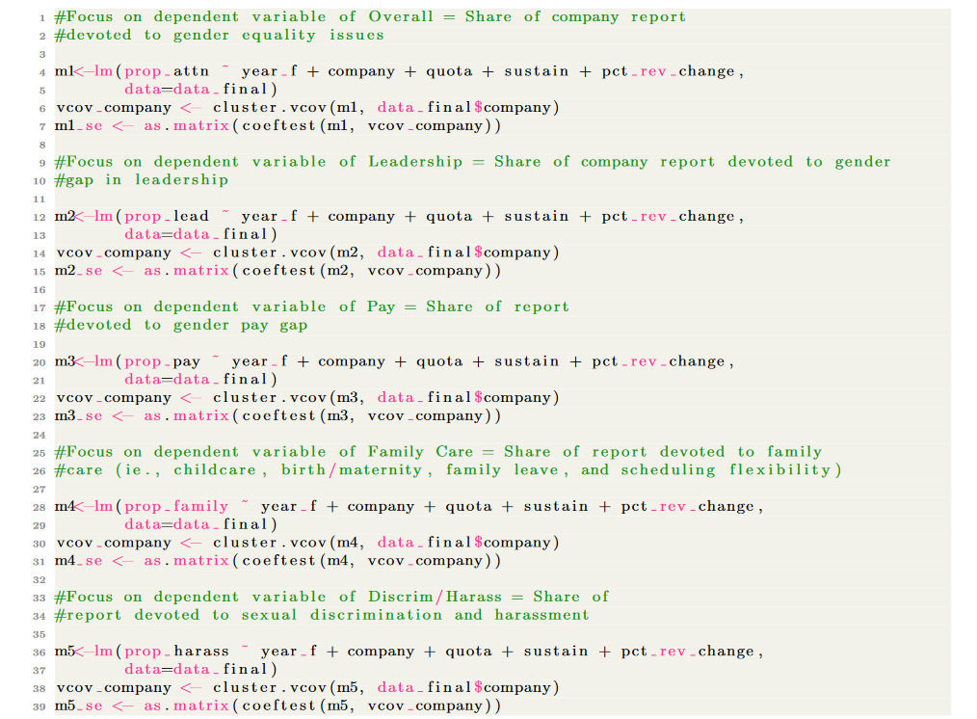
Original Additive Model- Code
Original Additive Model- Evidence Supporting H1 and H2-

Slide 6
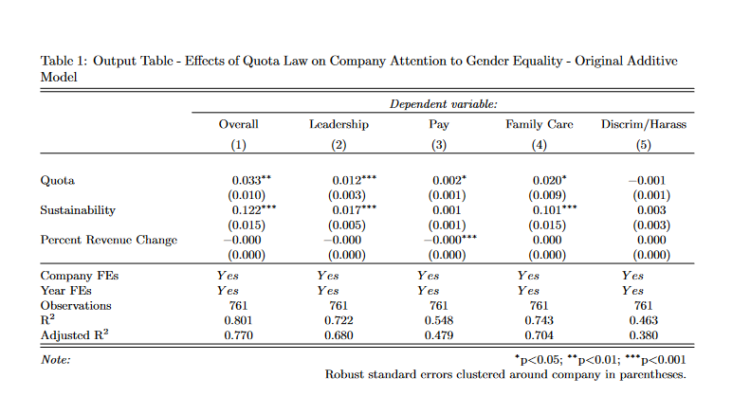
Original Additive Model- Output
Original Additive Model- Evidence Supporting H1 and H2-

Slide 7
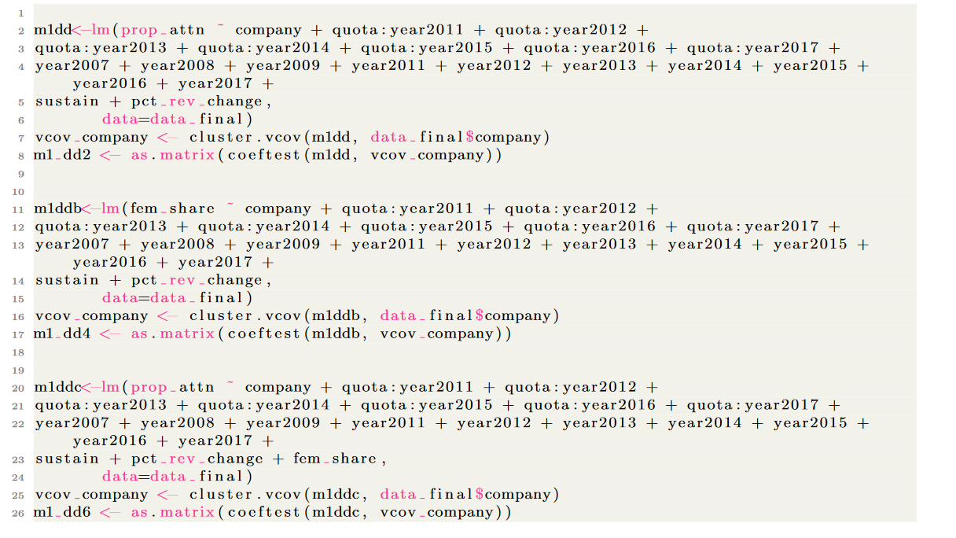
Code- Interactive Model Testing for H3-
Interactive model used to test for spillover effects:

Slide 8
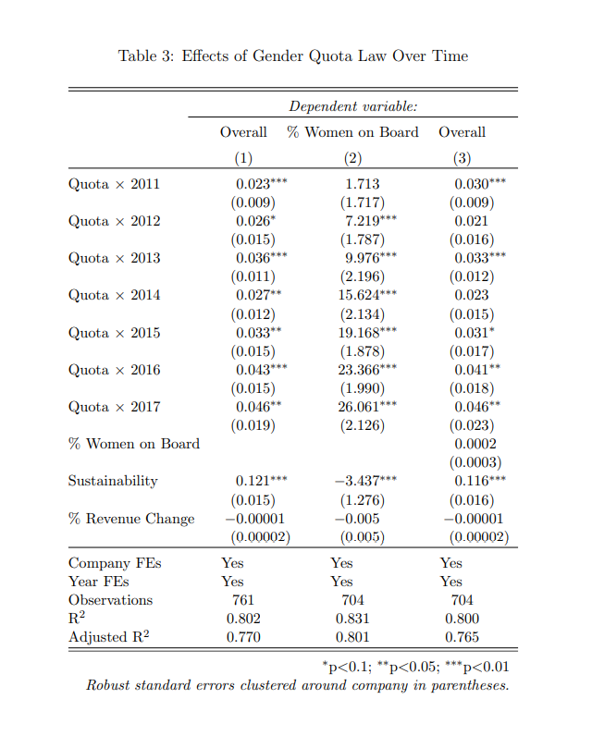
Output of Interactive Model Testing for H3-
Interactive model used to test for spillover effects-
Conclusion drawn:
“Companies started making changes right after adoption, before companies had a chance to change their boards, suggesting a spillover effect of the quota independent of women on the board.” (Latura & Weeks, 2021: 28)

Slide 9
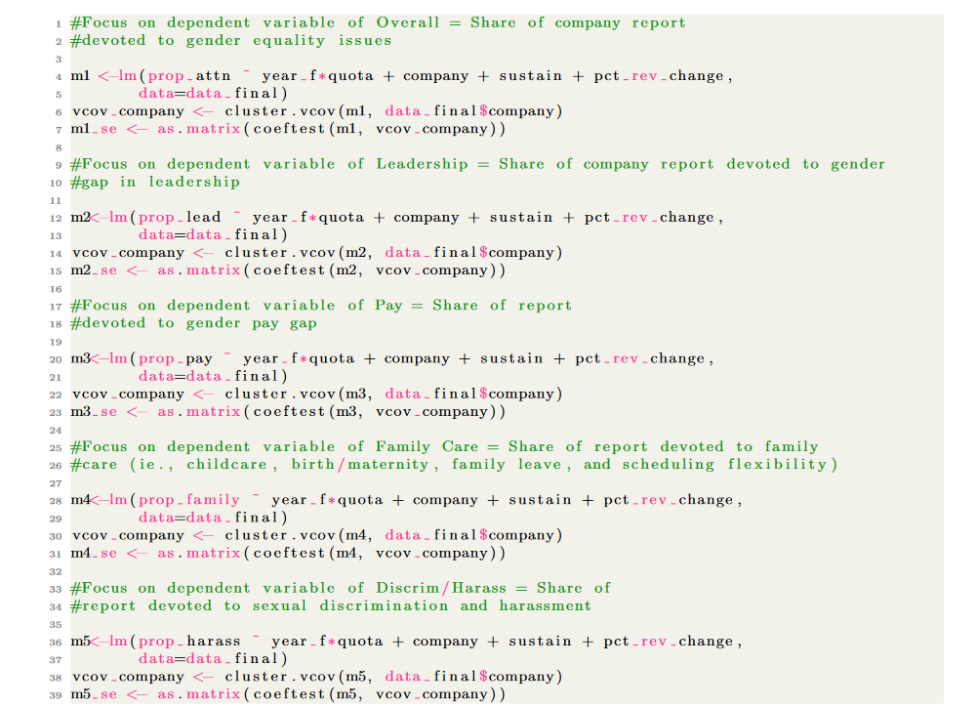
Expected Code for Interactive Model Testing for H3-
Why was the interaction done this way and not the way I expected?
Formula stated in study:
Yit = β1Quotait ∗ Y ear + β2Sustainabilityit + β3% Revenue Changeit + αi + ηt + µit

Slide 10
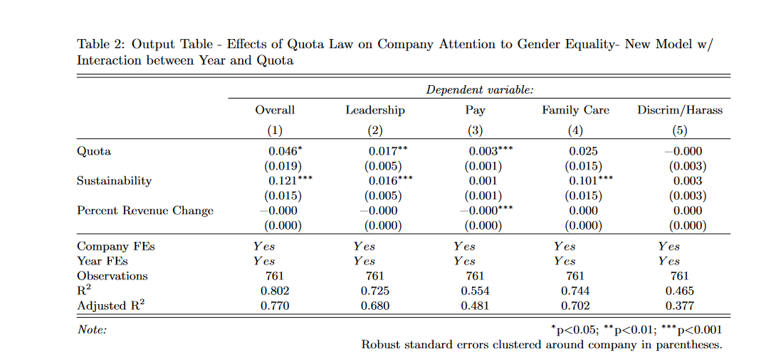
Expected Output for Interactive Model Testing for H3-
Why was the interaction done this way and not the way I expected?

Slide 11
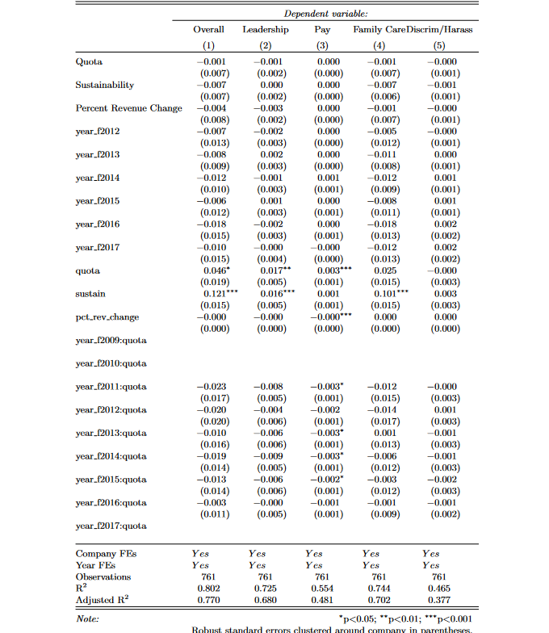
Output of Alternative Expected Interactive Model Testing for H3 showing individual year effects-
Why was the interaction done this way and not the way I expected?
- When we look at the effect by year here it looks incredibly messy and like not much of importance is happening

Slide 12
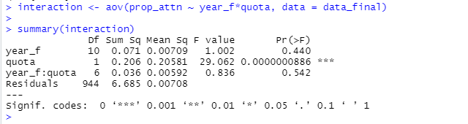
Interpretation of Anova:
- The ‘year_f:quota’ variable has a low sum-of-squares value and a high p-value, which means there is not much variation that can be explained by the interaction between year and quota. Doing the interaction in this way is therefore not very useful.
Further Interpretation:
***Note- law only got fully enforced in 2014 but started being implemented from 2011 onwards- there was a grace period where companies were gradually adopting it
Different approach may have been needed because of this to see the effect of each individual year after 2011 and to show an immediate effect before companies were even fully able to change their boards
Anova Test of the Interaction-

Slide 13
Additional Thoughts:
Why not a glm?
- Considered this when I looked originally, because I saw a lot of categorical variables, but realised that these were the independent explanatory variables and it’s all about what the outcome looks like
- not a logit because the outcome is not binary
- not a glm in general because the main outcome we are interested in, quota, is, in fact, continuous and not categorical in nature
- It is not using count variables in the outcome to describe the number of words, which would be discrete. The token counts are presented as a decimal and are therefore continuous.
- Because the outcome is continuous, an lm() regression is in fact appropriate here.

